Slide 1




CIT 596 MODULE 10.2
All-pairs Shortest paths by Matrix Multiplication
Sampath Kannan

Slide 2


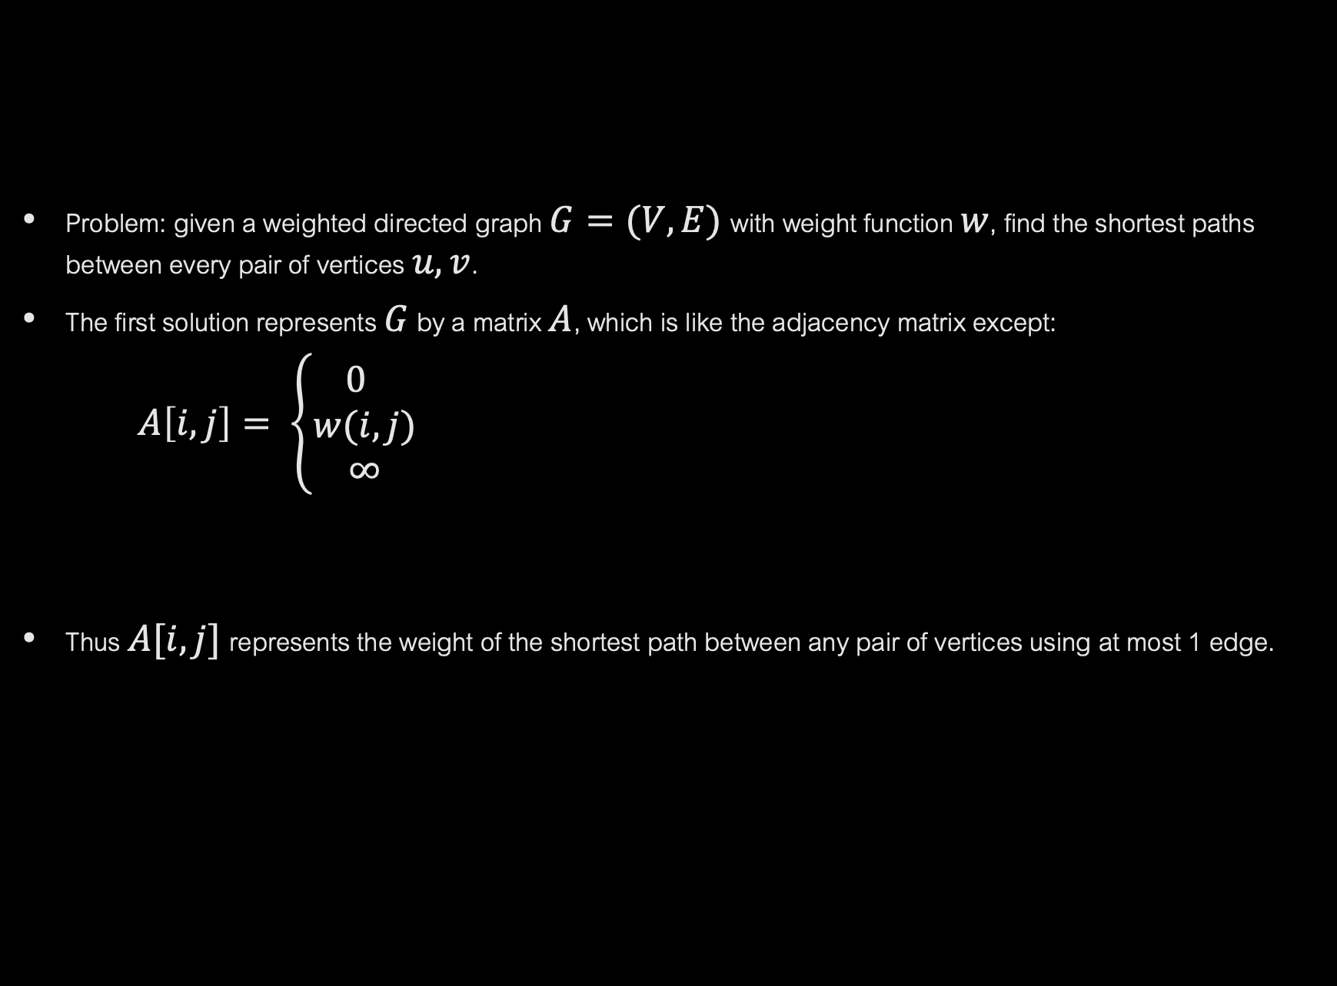
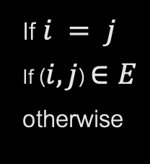
ALL PAIRS SHORTEST PATH PROBLEM
Problem: given a weighted directed graph $G=(V, E)$with weight function $w$, find the shortest paths between every pair of vertices $u, v$.
The first solution represents $G$ by a matrix $A$, which is like the adjacency matrix except:
$A\left[i, j\right]= \left\{\begin{aligned}0 \\ w(i, j) \\ \text{∞}\end{aligned}\right.$
Thus $A[i, j]$represents the weight of the shortest path between any pair of vertices using at most 1 edge.
If $i = j$
If ($i, j$) $∈E$
otherwise
1
1
7
2
1
2
2
3
4
5
3

Slide 3





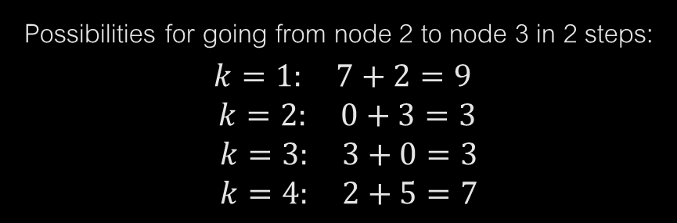
ALL PAIRS SOLUTION 1
How do we find the weight of the shortest path using at most 2 edges?
A path from $i$to $j$using 2 edges goes through an intermediate vertex $k$.
The weight of the length 2 path $i ↝ k ↝ j$is $A[i, k] + A[k, j]$.
If we consider every possible $k$ we would have considered every way of going from $i$ to $j$ in (at most) two hops.
$$j$$
$\left[\begin{matrix}0 & \text{∞} & 2 & 1 \\ 7 & 0 & 3 & 2 \\ \text{∞} & \text{∞} & 0 & 1 \\ 2 & \text{∞} & 5 & 0\end{matrix}\right]$
$$\left[\begin{matrix}0 & \text{∞} & 2 & 1 \\ 7 & 0 & 3 & 2 \\ \text{∞} & \text{∞} & 0 & 1 \\ 2 & \text{∞} & 5 & 0\end{matrix}\right]$$
Possibilities for going from node 2 to node 3 in 2 steps:
$$k=1: 7+2=9$$
$k=2: 0+3=3$
$k=3: 3+0=3$
$k=4: 2+5=7$
$$i$$
This looks like a matrix multiplication except. . .

Slide 4

ALL PAIRS SOLUTION 1 (CONTINUED)
In normal matrix multiplication, we multiply corresponding entries and add the products.
Here, we add corresponding entries and take the minimum of these sums.
Using this kind of multiplication, we get a matrix that we’ll denote as $A_{2}$.
We can repeat this to get $A_{3}$, $A_{4}$, . . . until we get $A_{n−1}$.
$A_{n−1}$ [$i , j$] is the weight of the shortest path from $i$ to $j$ of length at most $n − 1.$Thus it is the shortest-weight simple path from $i$ to$j$.
Next, we use induction to prove that $A_{i+1}$ has weights of shortest paths of at most $i+1$ hops between every pair of vertices (assuming $A_{i}$ has shortest-path weights for $i$-hop paths).
K₁
i
K₂
j
K₃

Slide 5

INDUCTIVE PROOF
A path with (at most) $ℓ+1$ hops is a path with (at most) $ℓ$ hops followed by a single edge.
A path from $i$ to $j$ of $ℓ+1$ hops is a path from $i$ to $k$ of $ℓ$ hops and an edge from $k$ to $j$.
Note that $k$ could be $j$ if a path of length $ℓ$ or less is actually the best.
By considering every possible $k$, adding the weight of the best path of length at most $ℓ$ from $i$ to $k$ to the weight of the edge from $k$ to $j$, and taking the minimum over all $k$, we are finding the best path of length at most $ℓ+1.$

Slide 6
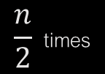

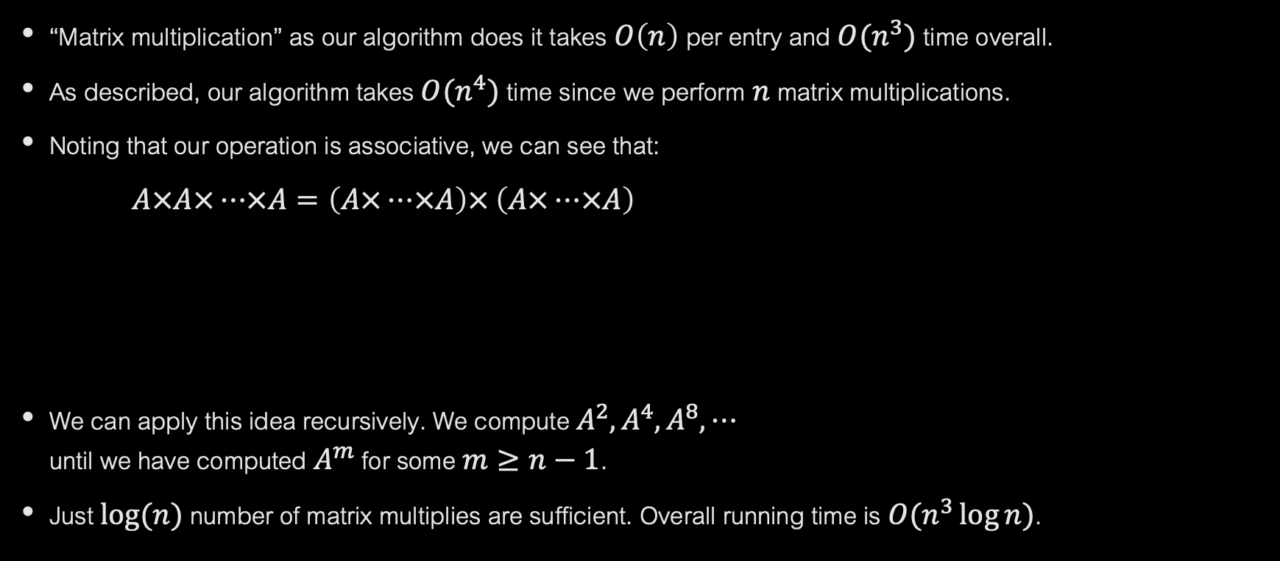
RUNNING TIME
“Matrix multiplication” as our algorithm does it takes $O\left(n\right)$ per entry and $O(n^{3})$ time overall.
As described, our algorithm takes $O(n^{4})$ time since we perform $n$ matrix multiplications.
Noting that our operation is associative, we can see that:
$A×A×⋯×A=\left(A×⋯×A\right)×$ $\left(A×⋯×A\right)$
We can apply this idea recursively. We compute $A^{2},A^{4},A^{8},⋯$ until we have computed $A^{m}$ for some $m≥n−1$.
Just $\log{(n)}$ number of matrix multiplies are sufficient. Overall running time is $O(n^{3}\log{n)}$.
$$n \text{times}$$
$$\frac{n}{2} \text{times}$$
$$\frac{n}{2} \text{times}$$

Slide 7

WHY IS THIS DYNAMIC PROGRAMMING?
Subproblems are shortest path problems with restriction on the maximum number of edges.
We write a recurrence for the weight of the shortest path with $≤k$ hops in terms of the weights of shortest paths with $≤k−1$ hops.
Base cases of paths with 1 edge are easy.
There are not too many subproblems.

Slide 8
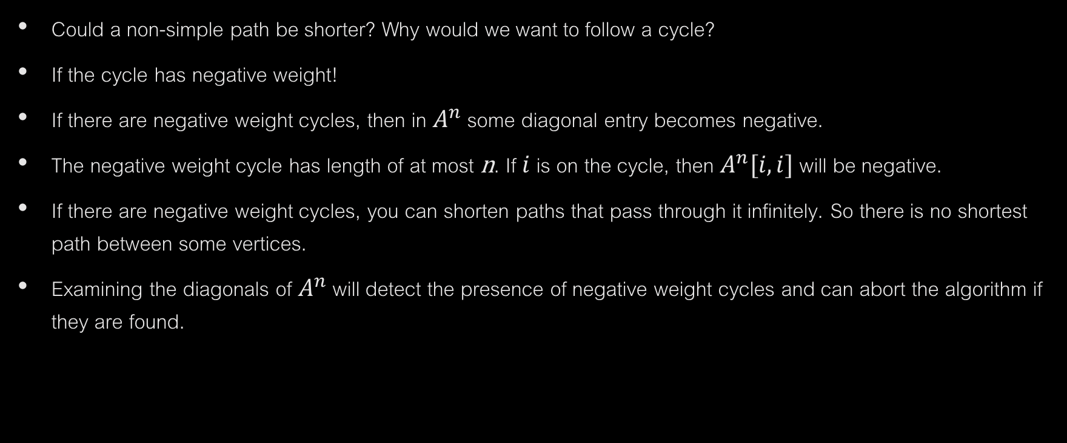
NON-SIMPLE PATHS
Could a non-simple path be shorter? Why would we want to follow a cycle?
If the cycle has negative weight!
If there are negative weight cycles, then in $A^{n}$ some diagonal entry becomes negative.
The negative weight cycle has length of at most n. If $i$ is on the cycle, then $A^{n}[i,i]$ will be negative.
If there are negative weight cycles, you can shorten paths that pass through it infinitely. So there is no shortest path between some vertices.
Examining the diagonals of $A^{n}$ will detect the presence of negative weight cycles and can abort the algorithm if they are found.

Slide 9



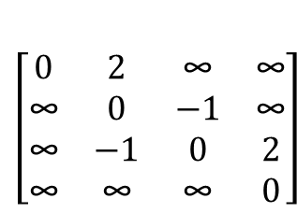
EXAMPLE
2
2
$\left[\begin{matrix}0 & 2 & \text{∞} & \text{∞} \\ \text{∞} & 0 & −1 & \text{∞} \\ \text{∞} & −\text{1} & 0 & 2 \\ \text{∞} & \text{∞} & \text{∞} & 0\end{matrix}\right]$
$\left[\begin{matrix}0 & 2 & \text{1} & \text{∞} \\ \text{∞} & −2 & −1 & \text{1} \\ \text{∞} & −\text{1} & −2 & 2 \\ \text{∞} & \text{∞} & \text{∞} & 0\end{matrix}\right]$
2
$A^{1}$=
1
-1
4
$A^{2}$=
-1
-1
-1
3
3
2

